Slide 1
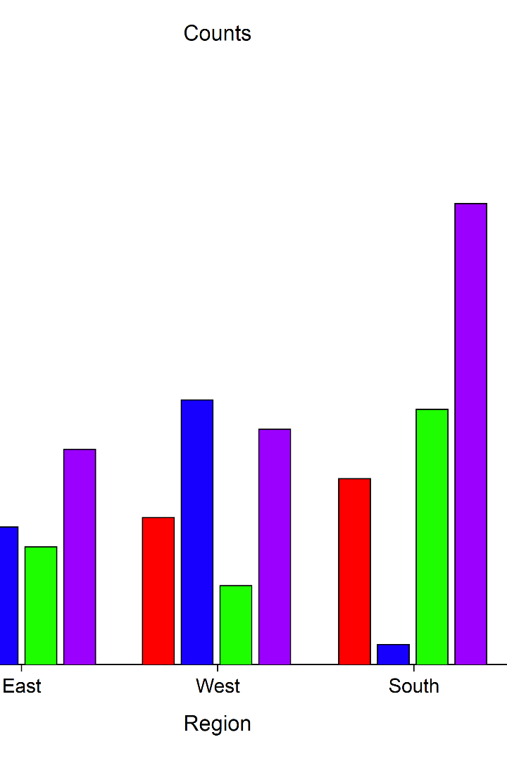
Exploratory Data Analysis
Exploratory Data Analysis is a crucial step in the data analysis process. This step involves examining and summarizing the main characteristics of a dataset to gain insights and to understand the data better.
TEAM MEMBER
T.PRAVEEN-12206514
KARTHIK REDDY-12201594
VENU KRISHNA YADAV-12206177

Slide 2
Introduction
The dataset under consideration encompasses a myriad of variables, including sales information numerical_data = data[[‘Age', ‘Total Spend’,
‘Items Purchased', ‘Days since Last Purchased'] ]
statistics = numerical_data.describe()
range_values = numerical_data.max() - numerical_data.min()
variance = numerical_data.var()
standard_deviation = numerical_data.std()
skewness = numerical_data.skew()
kurtosis = numerical_data.kurtosis()
statistics['Range'] = range_values
statistics['Variance'] = variance
statistics['Standard Deviation'] = standard_deviation
statistics['Skewness'] = skewness
statistics['Kurtosis'] = kurtosis
print(statistics)
Through these scenarios, the objective is to showcase the significance of these statistical tools in extrapolating insights from limited but
representative samples, thereby enabling data-driven decision-making and enhancing the understanding of larger datasets in real-world applications.

Slide 3

Exploratory Data Analysis
1. Data Cleaning:
This involves handling missing values, dealing with outliers, and removing duplicates
to ensure the data is in a suitable format for analysis.
2. Descriptive Statistics:
You calculate and analyze measures of central tendency (such as mean, median, and mode)
and measures of dispersion (such as range, variance, and standard deviation) to understand the distribution
and variability of the data.
3. Data Visualization:
This step involves creating visual representations of the data using plots, charts, and graphs. Common visualizations
include bar plots, histograms, scatter plots, box plots, and heatmaps. Visualizations help in identifying patterns, trends, and
relationships within the data.
4. Correlation Analysis:
You examine the relationships between variables to determine if there are any significant associations
or dependencies. This can be done by calculating correlation coefficients or creating scatter plots.
5. Feature Engineering:
This involves creating new features or transforming existing ones to extract more meaningful information
from the data. Feature engineering can help in improving the performance of machine learning models.

Slide 4
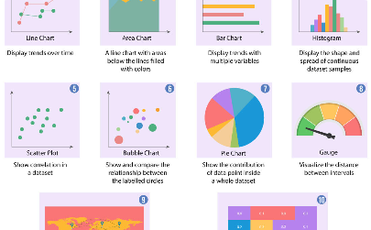
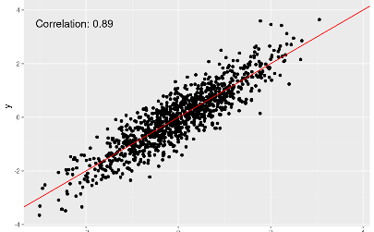
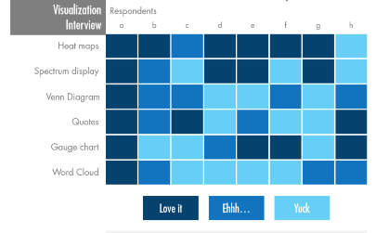
Data Visualization
Categorical Data
Numerical Data
Heat Maps
Bar charts, pie charts and stacked bar charts are used to display categorical data distributions and comparisons.
Scatter plots, line graphs and histograms are used to represent numerical data distributions and relationships.
Heat maps are used to represent data distributions over 2D or 3D space. They are useful for visualizing large datasets.

Slide 5

Scenario 1:
Estimating Total Spend in Cities
Understand the Dataset: The given dataset contains information about various customers including their Age, Annual Income, Spending Score (out of 100), and whether they use the internet to shop or not.
Data Analysis: Start by analyzing the dataset to identify patterns, relationships, and potential predictors for customer spending. This may involve creating descriptive statistics, correlations, and other relevant plots.
Data Preprocessing: Ensure the data is in a suitable format for analysis. This may involve cleaning the data (e.g., handling missing values, correcting data types, etc.), normalizing the data (e.g., scaling the values of different features to a similar range), and converting categorical variables into dummy variables or numerical equivalent.
Feature Selection: Select the most important features (or predictors) that are likely to influence customer spending. This can be achieved using methods such as correlation analysis, chi-square tests, or machine learning algorithms like Random Forest.
Model Building: Build a machine learning model that can predict customer spending based on the selected features. You can start with simple algorithms like Linear Regression and then progress to more complex algorithms like Random Forest, XGBoost, or Neural Networks.
Model Training and Testing: Split the dataset into a training set and a testing set. Use the training set to train the model and the testing set to evaluate its performance. Adjust the model parameters based on the results and retrain the model.
Model Interpretation: Understand the relationship between the predictors and the target variable by interpreting the coefficients of the trained model.
Predict Customer Spending: Using the trained model, predict the 'Total Spend' for a new customer with given attributes

Slide 6
Scenario 2:
Evaluating Unit Price Variability for Item Price
1. Data Preparation: Gather the relevant data that includes information about item types and their corresponding unit prices. Ensure the data is clean, complete, and in a suitable format for analysis.
2. Data Exploration: Perform exploratory data analysis (EDA) to understand the distribution and variability of unit prices across different item types. This may involve visualizations, descriptive statistics, and comparative analysis.
3. Grouping by Item Type: Group the data by item type and calculate summary statistics for unit prices within each group. This can include measures such as mean, median, standard deviation, minimum, and maximum.
4. Visualize the Variability: Create visualizations, such as box plots or violin plots, to compare the unit price distributions across different item types. This will help in assessing the variability and identifying any outliers or patterns.
5. Statistical Analysis: Conduct statistical tests, such as analysis of variance (ANOVA) or Kruskal-Wallis test, to determine if there are significant differences in unit prices among the different item types. This will provide insights into the variability and help in making statistical inferences.
6. Interpretation and Conclusion: Analyze the results obtained from the data exploration and statistical analysis. Summarize the findings regarding the variability in unit prices for different item types and draw conclusions based on the evidence.
It's important to note that the specific techniques and visualizations used may vary depending on the nature of the data and the research question at hand. Adjust the steps and analysis accordingly to fit your specific dataset and objectives.

Slide 7
Units:
Measures of Central Tendency:
Mean: 31.5
Median: 31.5
Mode: 29
Measures of Variability:
Range: 5
Variance: 12.5
Standard Deviation: 3.5355339059327378
IQR: 2.5
Shape of the Distribution:
Skewness: nan
Kurtosis: nan

Slide 8
THANK
YOU!

